Slide 1
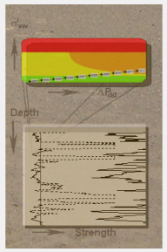
CORA engine FIST
Famke Kraaijeveld PTT/SPI, Isaac Foo PTU/E/Q

Slide 2
Uncertainty analysis in FIST and CORA
FIST comes with uncertainty analysis:
  Correlation procedure for Log / Core data
  Error is included as uncertainty in analysis
  Sensitivity analysis is available
  CORA – FIST interface allows
  More advanced sensitivity analysis (other PDFs)
  Take uncertainty in in-situ stress into account
  Calculate chance of non failure (reliability) per interval per date
  Analyse the effect of reservoir depletion on reliability

Slide 3
Constraints and best practices
  Ensure the FIST model is assembled correctly and can run on its own without errors before running the CORA-FIST engine. Disable critical drawdown calculation and sand quantification for CORA runs.
  Layer appears as Component in <Home> tab, but is not available for analysis
  TWCError is ‘ported’ from FIST and should not be altered unless there are compelling reasons to do so
    Make sure only 1 unique TWC relationship is active in the Correlation window – choose the most appropriate one
  Set number of parallel runs to 1
  PerfSizeEffectFactor and SizeEffectFactor (the latter for open hole completions) are usually mutually exclusive – choose one or the other
  WellInclination and WellAzimuth are uncertainties only at the well planning stage or if the uncertainties are clear from the final deviation surveys

Slide 4
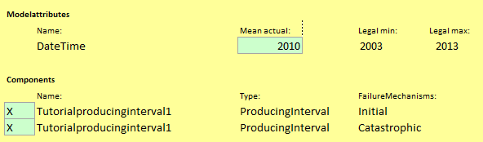
Supported features
  Proneness to sand production (sand failure risk) for producing intervals
    Available failure mechanisms:
      Initial (Pa) = M*TWC – sigma’_{v,nw}
      Catastrophic failure (Pa) (two different model)
    LSF = failure mechanism + Resistance
  Analysis holds for a certain date (as specified in ‘Mean actual’)
  Not supported:
  Massive transient and global shear failure
  Sand quantification
Date
Failure

Slide 5
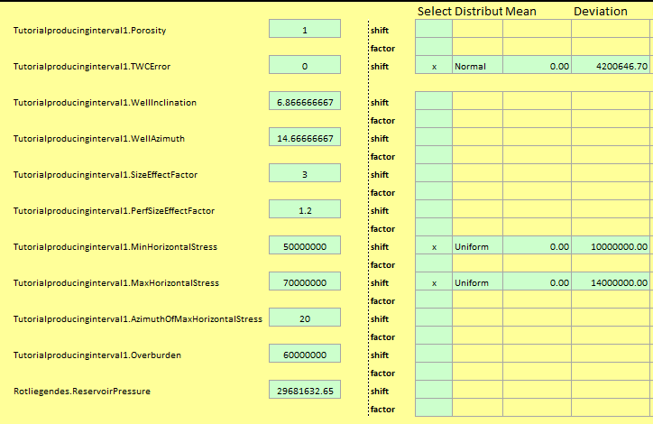
Parameters for uncertainty analysis
  Per component (producing interval)
    Material: Porosity, TWCError, SizeEffectFactor
    Geometrical: WellInclination, WellAzimuth, PerfSizeEffectFactor, SizeEffectFactor
    In Situ Stress: MinHorizontalStress, MaxHorizontalStress, AzimuthOfMaxHorizontalStress
  Per reservoir layer
    Loading: ReservoirPressure
PDFs

Slide 6
TWC
  TWC error bounds are determined within FIST
    Source: Core data regression / choice of default correlation / manually entered regression parameters
    Variation in TWC is always assumed to be normally distributed
    The error bounds for the active TWC relationship in the FIST model are ‘ported’ to CORA
    Note that FIST will not run if no relationship between TWC and a log variable (e.g. porosity, DTC, DTS etc.) is specified in FIST
  For testing single value TWC
    Enter in FIST a simple log with several data points with the same value
    2 usually suffice for a simple case with 1 Producing Interval – one at the top of the Producing Interval, one at the bottom
    Log value entered should produce the mean TWC to be tested

Slide 7
FIST workflow

Slide 8
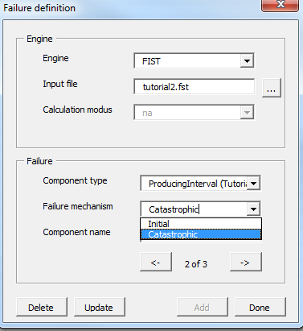
Define failure model
The model including objects of failure and failure mechanism are defined here.
Step 1: Choose your engine: FIST
Step 2: Browse to the FIST file, which has to be built beforehand
Step 3: Select the object of failure and appropriate failure mechanisms
Step 4: Press <Add>
Repeat until <Done>
Notes:
Should we show a slide on Settings?

Slide 9
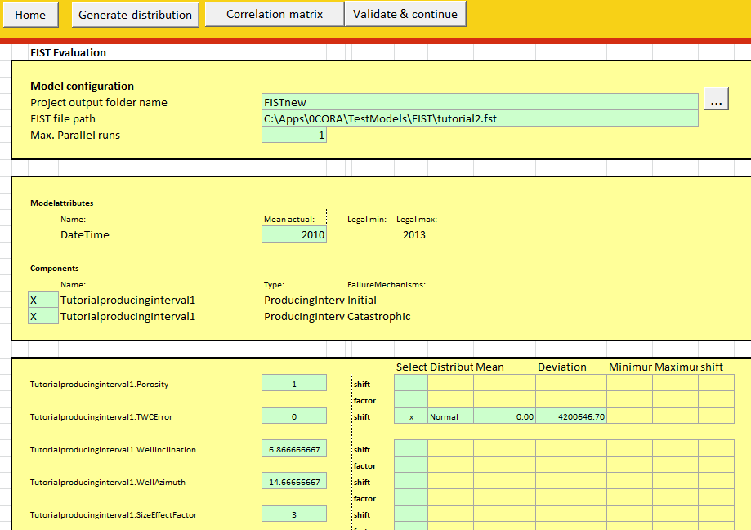
Define uncertainties
Only uncertainties need to be inputted.
Step 1: Go to sheet <FIST>
Step 2: Fill in calculation path and number of parallel threads
Step 3: Select the failure mechanisms and define date of interest
Step 4: Define the uncertainty distributions and correlations
(Button <Correlation matrix>)
Step 6: Define min, max and step size
for the control parameters (reliability analysis)
Step 7: When satisfied press
<Validate and continue>
LSFs
PDFs

Slide 10
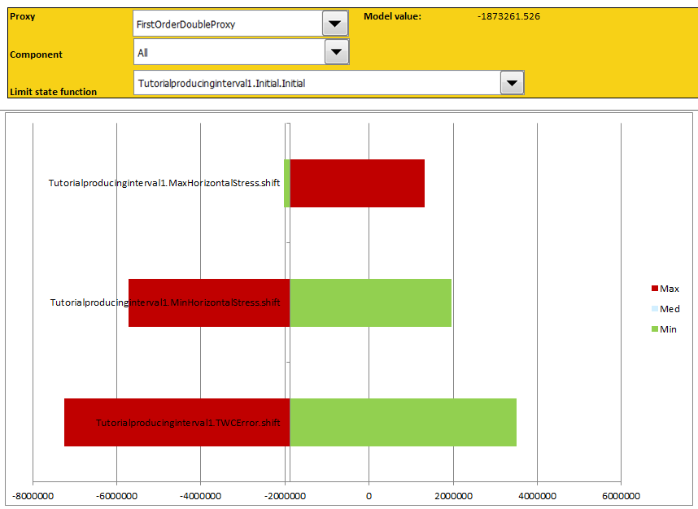
Further analysis
The rest of the workflow is the same as for the other engines.
Quick screening:
  In the quick screening, all failure mechanisms will be calculated. The relation between the parameters and the responses can be analysed by examining the different proxies.
  Reliability analysis
  The limit function of choice can be selected or all
  The limit of failure should be given (e.g. Resistance)

